Slide 1
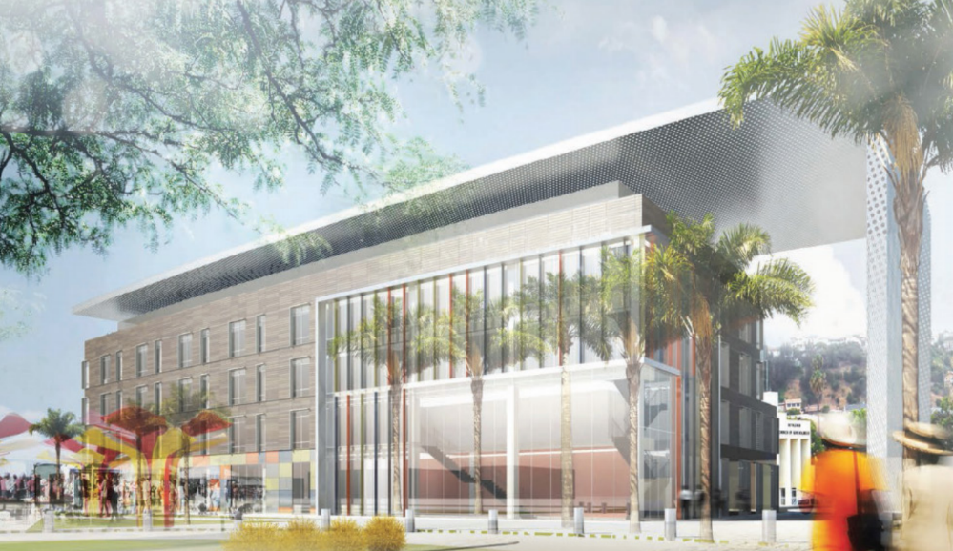
The Non-Profit Outpatient Medical Facility
Southern California
Tena Pettit | Lighting + Electrical

Slide 2
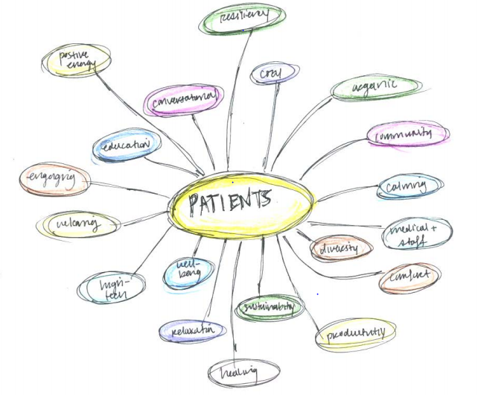

Slide 3
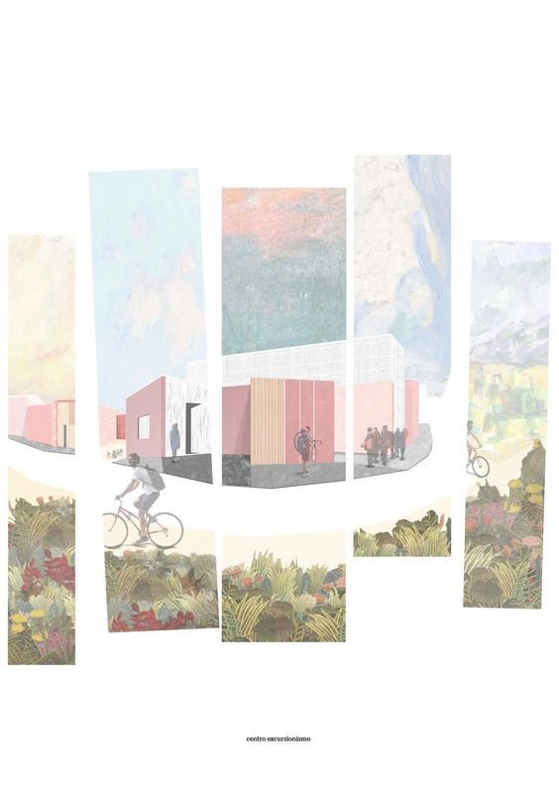

Slide 4
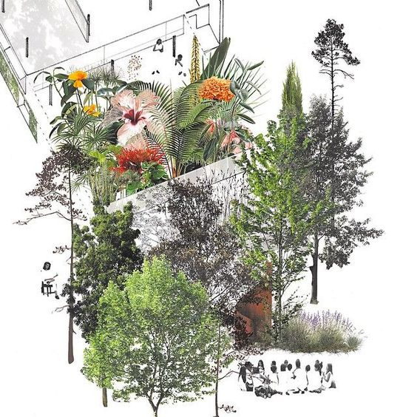

Slide 6
Biophilia
love of life or living systems
Medical Staff
benefits
15%
Family + Community Benefits
Patients with View
Patients without View
Wellness Increase
Patient
benefits
8.71 days
7.96 days
15%
Reduces
Stress + Anxiety
Productivity Increase
Less painkillers
Overall Improved experience
6%
Creativity Increase

Slide 7
healthy building = healthy environment = healthy people

Slide 8
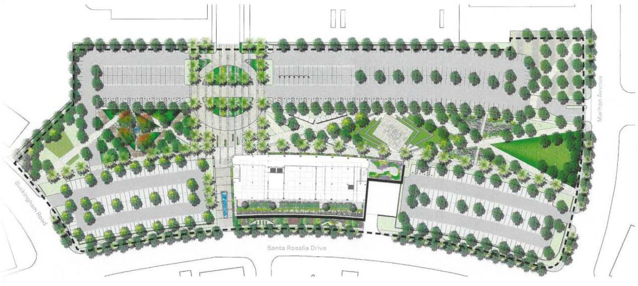
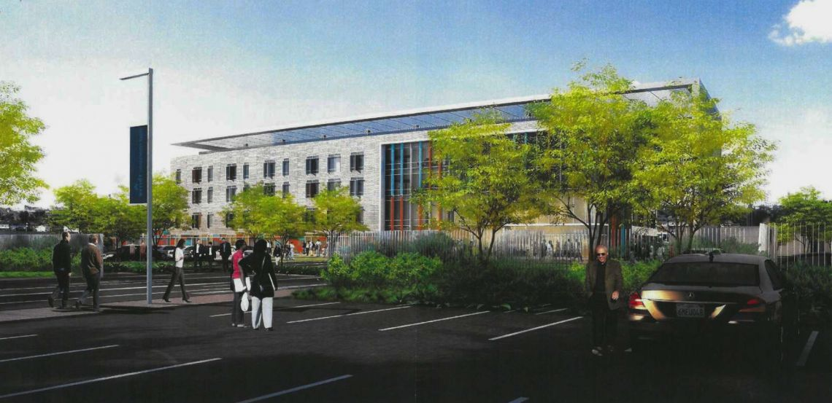
The Non-Profit Outpatient Medical Facility
Location | Southern California
Site Size | 216,970 SF
Building Size | 4 stories, 105,000 SF
Architect | HOK
Lighting Designer | HLB Lighting Design
Electrical Engineer | DPB Engineers, Inc.
Overall Project Cost | $90 million
Date Completed | October 2017
The Building
Project Statistics
Integrated + Sustainable Breadths
Lighting Design
Lobby Space
Daylighting Design
Lighting Design
Nurse Station
Lighting Design
Patient Room
Electrical Depth
Concluding Thoughts

Slide 9
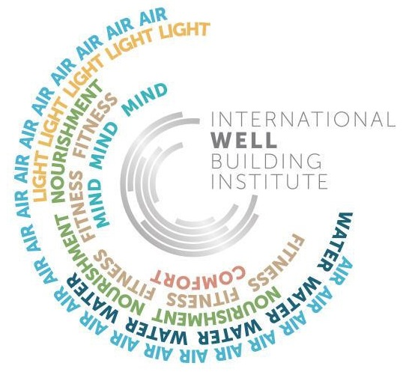
The Non-Profit Outpatient Medical Facility
The Building
Integrated + Sustainable Breadths
Lighting Design
Lobby Space
Daylighting Design
Lighting Design
Nurse Station
Lighting Design
Patient Room
Electrical Depth
Concluding Thoughts

Slide 10
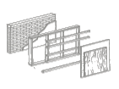
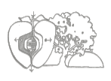
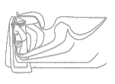
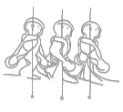
The Non-Profit Outpatient Medical Facility
Energy
Materials
The Building
Health + Happiness
Integrated + Sustainable Breadths
Lighting Design
Place
Lobby Space
Daylighting Design
Civilized Environment
Beauty
Biophilic Environment
Lighting Design
Nurse Station
Lighting Design
Patient Room
Equity
Beauty + Spirit
Inspiration + education
Electrical Depth
Concluding Thoughts
Universal Access to Nature + Place
Water

Slide 11
The Non-Profit Outpatient Medical Facility
The Building
Health + Happiness
Integrated + Sustainable Breadths
Lighting Design
Place
Lobby Space
Daylighting Design
Civilized Environment
Beauty
Biophilic Environment
Lighting Design
Nurse Station
Lighting Design
Patient Room
Equity
Beauty + Spirit
Inspiration + education
Electrical Depth
Concluding Thoughts
Universal Access to Nature + Place

Slide 12
The Non-Profit Outpatient Medical Facility
Air
The Building
Comfort
Integrated + Sustainable Breadths
Mind
Lighting Design
Lobby Space
Daylighting Design
Fitness
Lighting Design
Nurse Station
Light
Lighting Design
Water
Patient Room
Electrical Depth
Nourishment
Concluding Thoughts

Slide 13
The Non-Profit Outpatient Medical Facility
The Building
Integrated + Sustainable Breadths
Mind
Lighting Design
Lobby Space
Daylighting Design
Fitness
Lighting Design
Nurse Station
Light
Lighting Design
Patient Room
Electrical Depth
Nourishment
Concluding Thoughts

Slide 14
The Non-Profit Outpatient Medical Facility
Place
The Building
Equity
Mind
Integrated + Sustainable Breadths
Human Powered Living
Lighting Design
Lobby Space
Nourishment
Daylighting Design
Universal Access to Nature + Place
Lighting Design
Fitness
Nurse Station
Beauty
Health + Happiness
Lighting Design
Patient Room
Beauty + Spirit
Civilized Environment
Electrical Depth
Inspiration + education
Biophilic Environment
Light
Concluding Thoughts

Slide 15
The Lobby
Lighting Design +
Daylighting Analysis

Slide 16
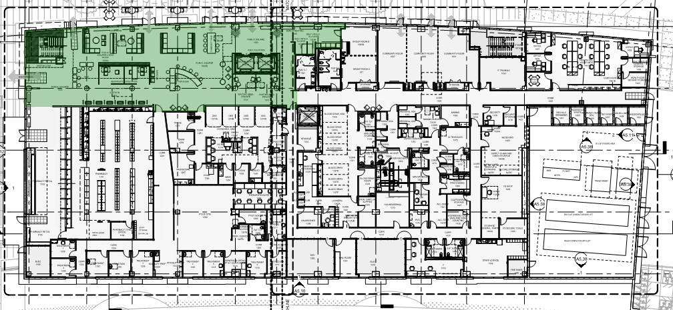
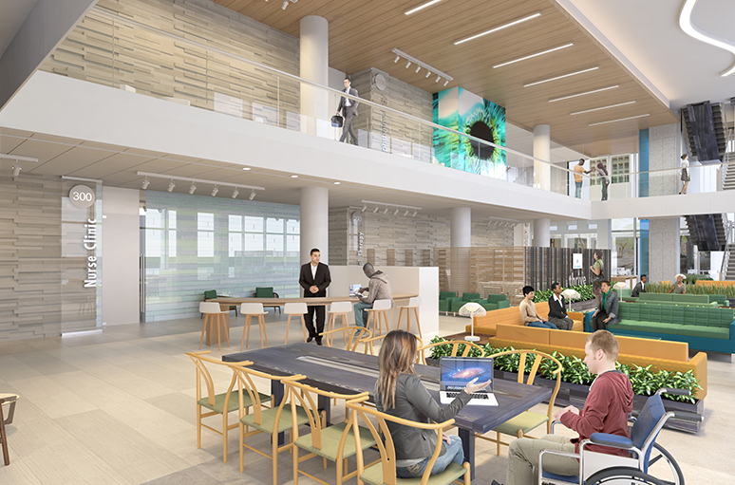
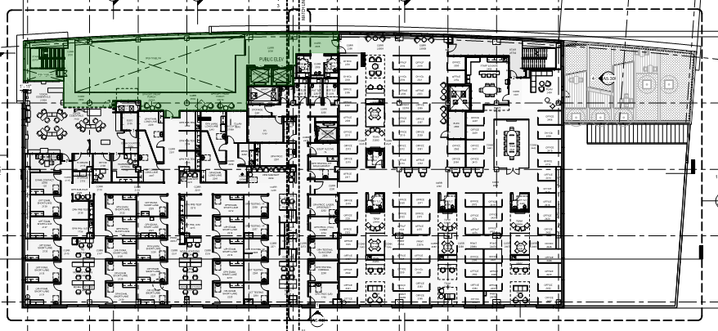
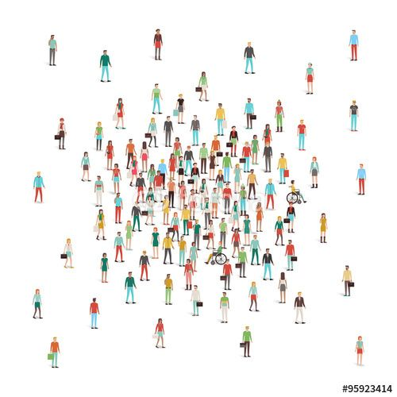
The Non-Profit Outpatient Medical Facility
The Building
First Level
Integrated + Sustainable Breadths
Lighting Design
Lobby Space
Daylighting Design
Second Level
Lighting Design
Nurse Station
Lighting Design
Lighting Design
Patient Room
Electrical Depth
Concluding Thoughts

Slide 17
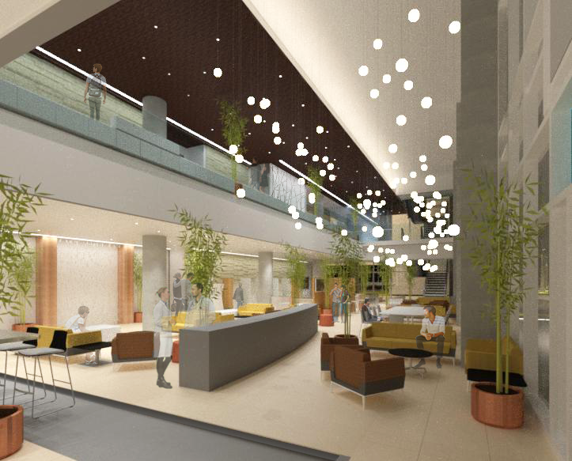
The Non-Profit Outpatient Medical Facility
Light
The Building
Civilized Environment
Integrated + Sustainable Breadths
Human Powered Living
Lighting Design
Fitness
Lobby Space
Daylighting Design
Nourishment
Lighting Design
East View Lighting Design
Nurse Station
Biophilic Environment
Lighting Design
Patient Room
Mind
Electrical Depth
Beauty + Spirit
Concluding Thoughts
Universal Access to Nature + Place

Slide 18
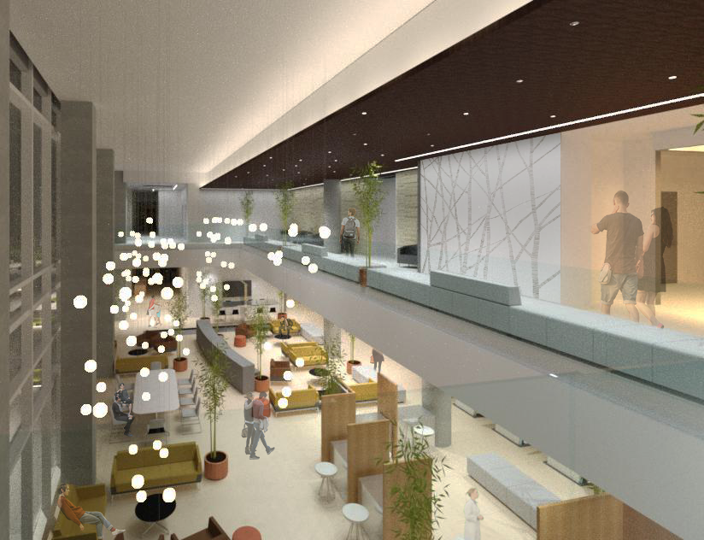
The Non-Profit Outpatient Medical Facility
The Building
Integrated + Sustainable Breadths
Lighting Design
Lobby Space
Daylighting Design
Lighting Design
East View Lighting Design
West View Lighting Design
Nurse Station
Lighting Design
Patient Room
Electrical Depth
Concluding Thoughts

Slide 19
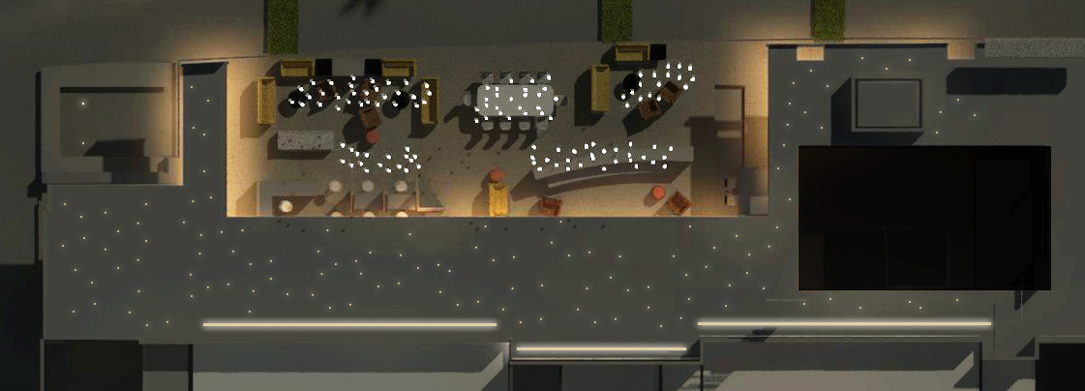
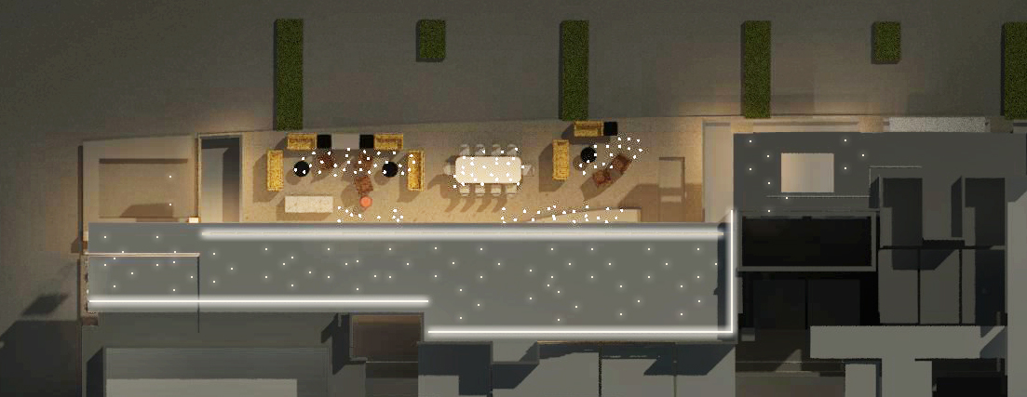
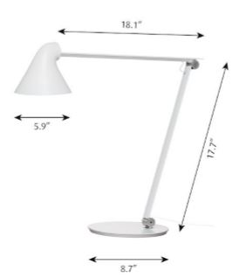
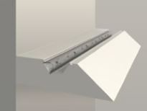
The Non-Profit Outpatient Medical Facility
The Building
Integrated + Sustainable Breadths
First Level
Lighting Design
Lobby Space
Daylighting Design
Luminaire Selection
Lighting Design
Nurse Station
Lighting Design
Patient Room
Second Level
Electrical Depth
Concluding Thoughts

Slide 20
The Non-Profit Outpatient Medical Facility
IES Design Criteria
The Building
Space | Illuminance Level [hor] | Average Illuminance Level [hor] Calculated | Met Criteria?
General Lobby [1st + 2nd Floors] | 20 fc | 36 fc | Yes
First Floor Table Surfaces | 30 fc | 31 fc | Yes
Main staircase | 10 fc | 12 fc | yes
Integrated + Sustainable Breadths
Lighting Design
Lobby Space
Daylighting Design
Design Solution
Lighting Design
Nurse Station
Lighting Design
Patient Room
Title 24 LPD Criteria
Electrical Depth
LPD Allowance: 1.5 W/SF
LPD Calculated: 0.89 W/SF
Concluding Thoughts
Met Criteria
LLF: 0.8

Slide 21
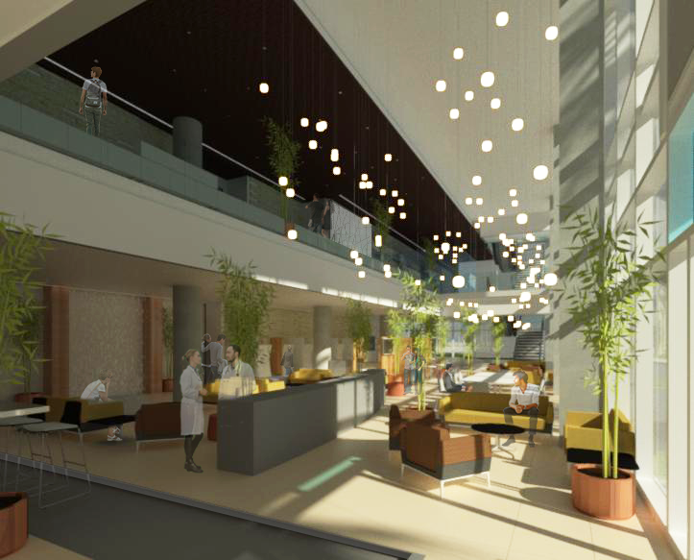
The Non-Profit Outpatient Medical Facility
The Building
Integrated + Sustainable Breadths
Lighting Design
Lobby Space
Daylighting Design
Lighting Design
Nurse Station
Daylighting
Lighting Design
Patient Room
Electrical Depth
Concluding Thoughts

Slide 22
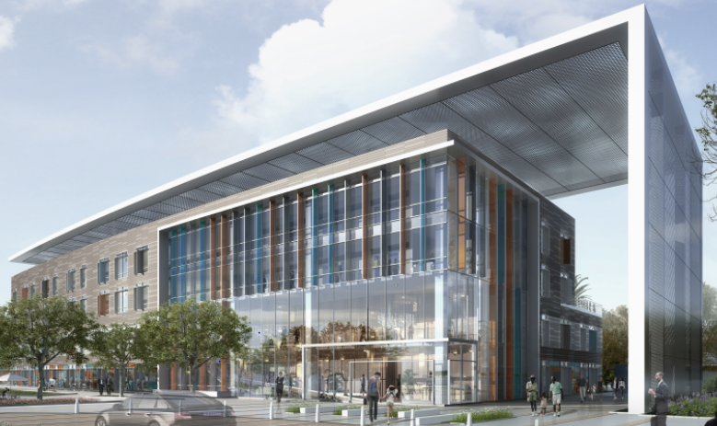
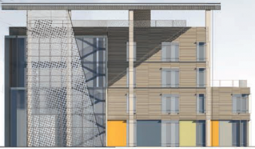
The Non-Profit Outpatient Medical Facility
The Building
Integrated + Sustainable Breadths
Lighting Design
Lobby Space
Daylighting Design
Lighting Design
Nurse Station
Daylighting Scope
Lighting Design
Patient Room
Site Orientation
Electrical Depth
Concluding Thoughts

Slide 23
The Non-Profit Outpatient Medical Facility
Light
The Building
Integrated + Sustainable Breadths
Civilized Environment
Lighting Design
Lobby Space
Daylighting Design
Daylight Analysis
Daylight Autonomy [DA]
Lighting Design
Nurse Station
Lighting Design
Annual Sunlight Exposure [ASE]
Patient Room
Electrical Depth
Energy Usage +
Solar Heat Gain Analysis
Concluding Thoughts

Slide 24
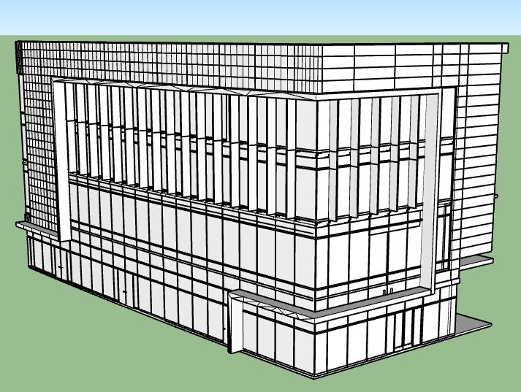
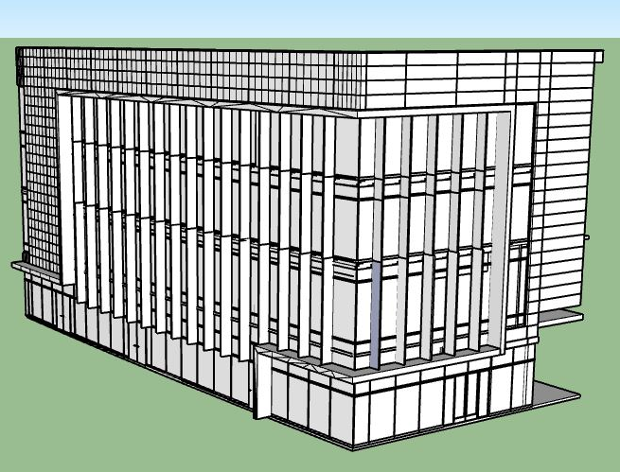
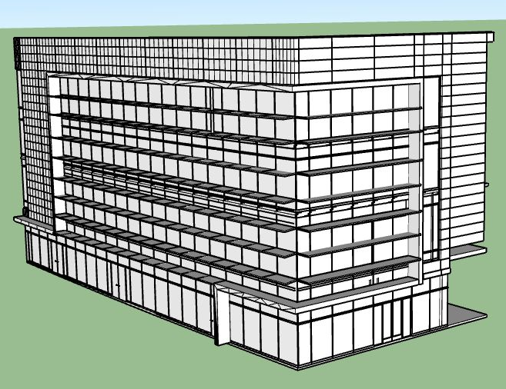
The Non-Profit Outpatient Medical Facility
Software: SketchUp
The Building
Integrated + Sustainable Breadths
Model Scenarios
Lighting Design
Lobby Space
Daylighting Design
Lighting Design
Nurse Station
Lighting Design
Patient Room
Electrical Depth
Base Case
Case Study 1 - Vertical Louvers
Case Study ii - Horizontal Louvers
Concluding Thoughts

Slide 25
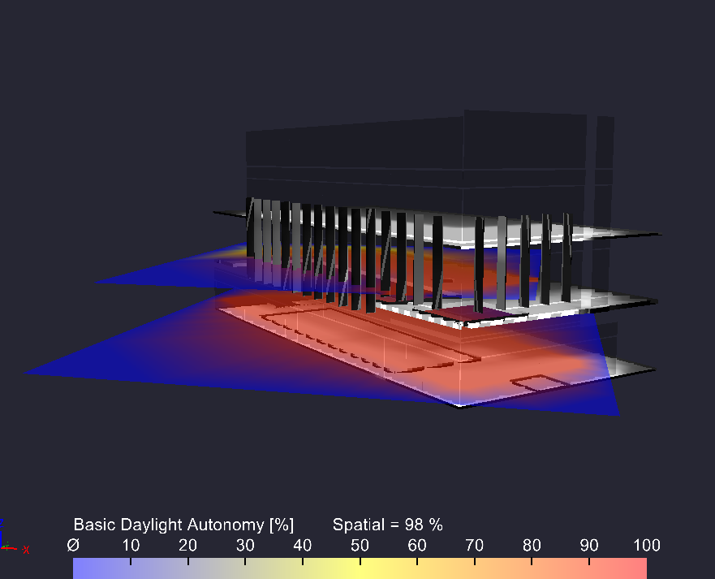
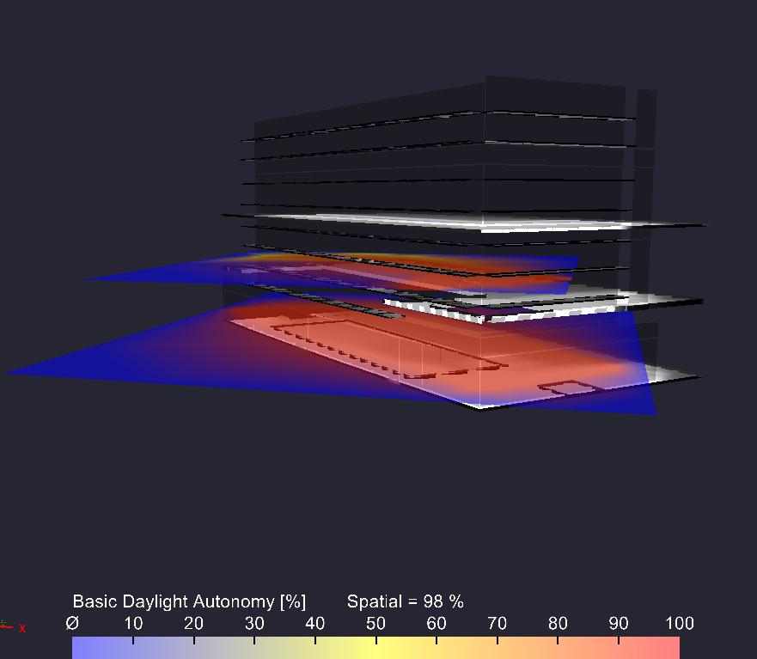
The Non-Profit Outpatient Medical Facility
Software: Licaso
The Building
Integrated + Sustainable Breadths
Daylight Autonomy
Lighting Design
Lobby Space
Daylighting Design
Lighting Design
Nurse Station
Lighting Design
Patient Room
Electrical Depth
Base Case
Case Study 1 - Vertical Louvers
Case Study ii - Horizontal Louvers
Concluding Thoughts

Slide 26
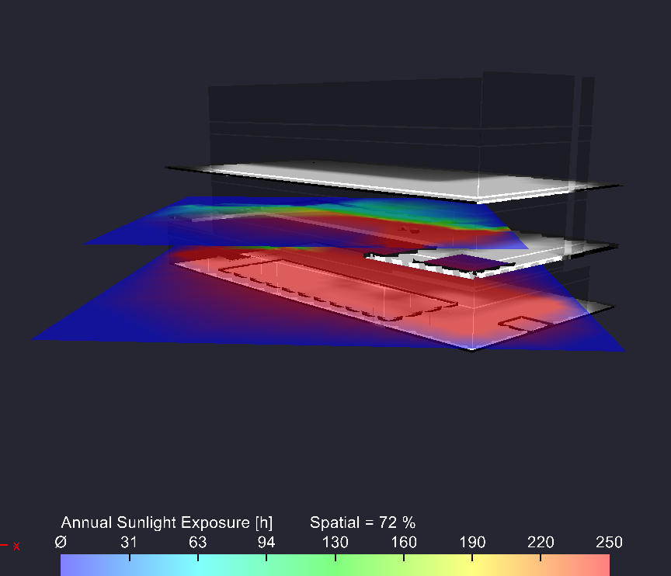
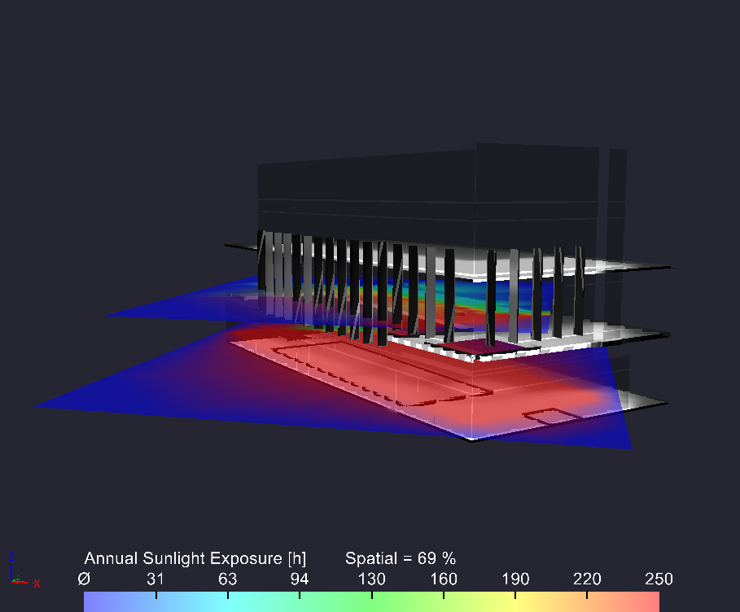
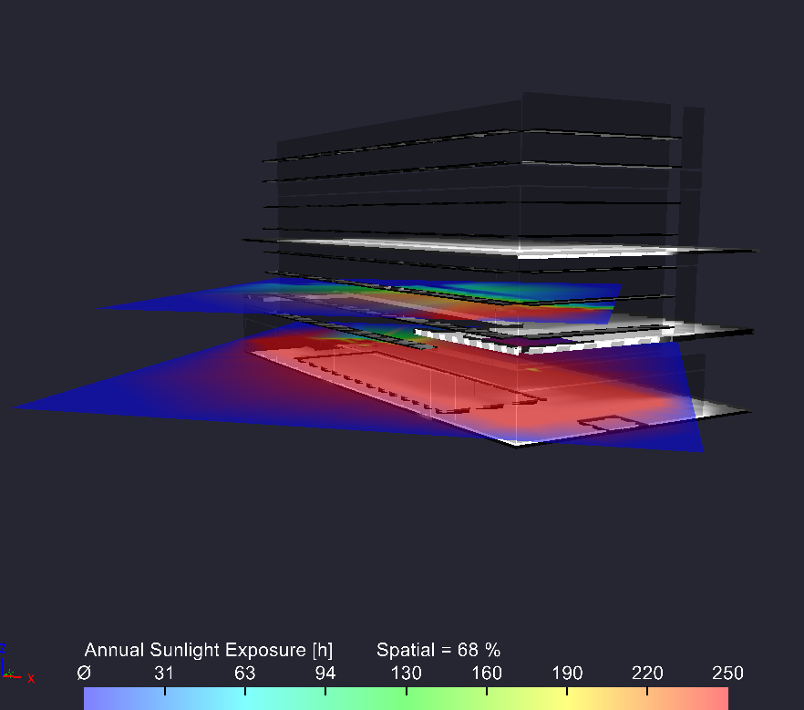
The Non-Profit Outpatient Medical Facility
Software: Licaso
The Building
Integrated + Sustainable Breadths
Annual Sunlight Exposure
Lighting Design
Lobby Space
Daylighting Design
Lighting Design
Nurse Station
Lighting Design
Patient Room
Electrical Depth
Base Case
Case Study 1 - Vertical Louvers
Case Study ii - Horizontal Louvers
Concluding Thoughts

Slide 27
The Non-Profit Outpatient Medical Facility
Software: Licaso
The Building
Integrated + Sustainable Breadths
Glazing System | Double Low Solar Low-E Clear [air]
Visual Transmittance | 0.701
Solar Heat Gain Coefficient [SHGC] | 0.382
U-Factor | 0.291
Glazing System | Double Glazed Triple Solar Low-E [argon]
Visual Transmittance | 0.638
Solar Heat Gain Coefficient [SHGC] | 0.272
U-Factor | 0.283
Glazing System Design
Lighting Design
Lobby Space
Daylighting Design
Lighting Design
Nurse Station
Lighting Design
Patient Room
Base Case
Case Study 1 - Vertical Louvers
Electrical Depth
Case Study ii - Horizontal Louvers
Concluding Thoughts

Slide 28
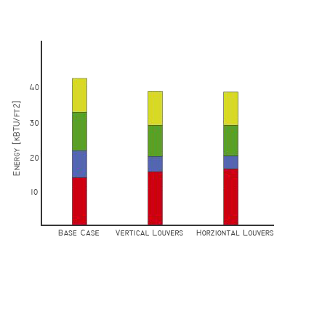
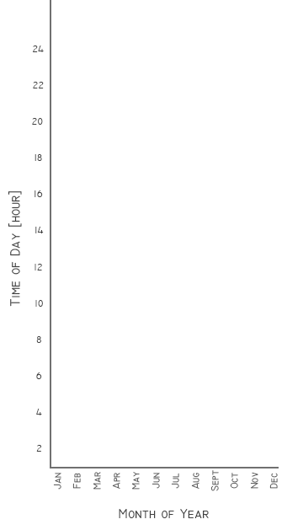
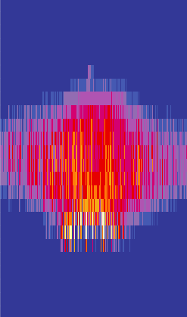
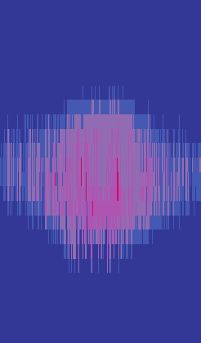
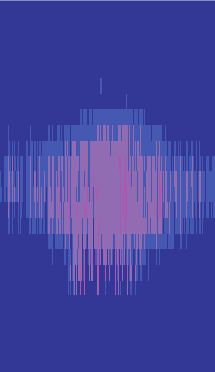
The Non-Profit Outpatient Medical Facility
Software: COMFEN5
Energy Usage
Façade Heat Gain
The Building
Integrated + Sustainable Breadths
lighting
Glazing System Design
fans
Lighting Design
Cooling
Lobby Space
Daylighting Design
Heating
Lighting Design
Nurse Station
Lighting Design
Patient Room
Electrical Depth
Base Case
Vertical Louvers
Horizontal Louvers
Concluding Thoughts

Slide 29
The Non-Profit Outpatient Medical Facility
Software: Licaso
The Building
Integrated + Sustainable Breadths
Glazing System | Double Low Solar Low-E Clear [air]
Visual Transmittance | 0.701
Solar Heat Gain Coefficient [SHGC] | 0.382
U-Factor | 0.291
Glazing System | Double Glazed Triple Solar Low-E [argon]
Visual Transmittance | 0.638
Solar Heat Gain Coefficient [SHGC] | 0.272
U-Factor | 0.283
Glazing System Design
Lighting Design
Lobby Space
Daylighting Design
Lighting Design
Nurse Station
Lighting Design
Patient Room
Base Case
Case Study 1 - Vertical Louvers
Electrical Depth
Case Study ii - Horizontal Louvers
Concluding Thoughts

Slide 30
The Non-Profit Outpatient Medical Facility
 | Base Case | Case Study I - Vertical Louvers | Case Study II - Horizontal Louvers
Façade Appearance | 1 | 2 | 3
Illuminance Levels | 1 | 2 | 3
Illuminance Effects | 1 | 3 | 2
DA | 1 | 1 | 1
ASE | 3 | 2 | 1
Energy Usage | 3 | 2 | 1
Average Window Heat Gain | 3 | 2 | 1
Façade Heat Gain | 3 | 2 | 1
Totals | 16 | 16 | 13
The Building
Integrated + Sustainable Breadths
Lighting Design
Lobby Space
Daylighting Design
Results
Lighting Design
Nurse Station
Lighting Design
Patient Room
Electrical Depth
Concluding Thoughts

Slide 31
The Non-Profit Outpatient Medical Facility
 | Base Case | Case Study I - Vertical Louvers | Case Study II - Horizontal Louvers
Façade Appearance | 1 | 2 | 3
Illuminance Levels | 1 | 2 | 3
Illuminance Effects | 1 | 3 | 2
DA | 1 | 1 | 1
ASE | 3 | 2 | 1
Energy Usage | 3 | 2 | 1
Average Window Heat Gain | 3 | 2 | 1
Façade Heat Gain | 3 | 2 | 1
Totals | 16 | 16 | 13
The Building
Integrated + Sustainable Breadths
Lighting Design
Lobby Space
Daylighting Design
Results + Redesign
Lighting Design
Nurse Station
Lighting Design
Patient Room
Electrical Depth
Concluding Thoughts

Slide 32
Nurse Station
Lighting Design

Slide 33
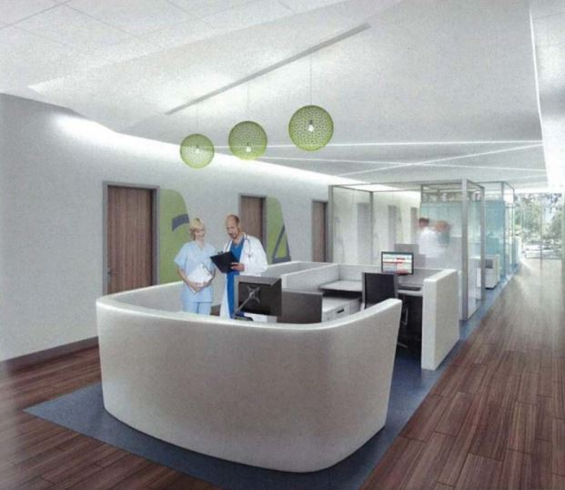
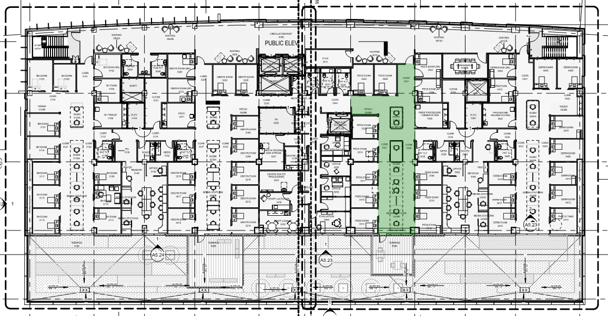
The Non-Profit Outpatient Medical Facility
The Building
Integrated + Sustainable Breadths
Fourth Level
Lighting Design
Lobby Space
Daylighting Design
Lighting Design
Nurse Station
Lighting Design
Patient Room
Electrical Depth
Concluding Thoughts

Slide 34
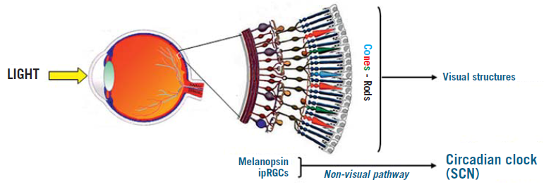
The Non-Profit Outpatient Medical Facility
Circadian Rhythm + Lighting
The Building
Circadian Rhythm
Biological rhythm in humans + animals that repeats approximately every 24 hours, acting as an internal clock
that synchronizes vital physiological functions
Integrated + Sustainable Breadths
Duration, Time, Illuminance Quantity, Spectrum
Lighting Design
Lobby Space
Daylighting Design
Lighting Design
Nurse Station
Lighting Design
Patient Room
Electrical Depth
Concluding Thoughts

Slide 35
The Non-Profit Outpatient Medical Facility
Circadian Rhythm + Lighting
The Building
Circadian Rhythm
Biological rhythm in humans + animals that repeats approximately every 24 hours, acting as an internal clock
that synchronizes vital physiological functions
Integrated + Sustainable Breadths
Duration, Time, Illuminance Quantity, Spectrum
Lighting Design
Lobby Space
Daylighting Design
Lighting Research Center
WELL Light Concept
Lighting Design
Nurse Station
Circadian Stimulus Metric
Equivalent Melanopic Lux
Percentage of melatonin suppression over a 1-hour light exposure as a means to quantify circadian stimulation
Lux measurement weighted to the ipRGCs in the retina as a means to measure the biological effects of light on humans
Lighting Design
Patient Room
Electrical Depth
Concluding Thoughts

Slide 36
The Non-Profit Outpatient Medical Facility
Lighting Research Center Model Study On Circadian Rhythm Lighting
The Building
Overhead
Integrated + Sustainable Breadths
100% output
Lighting Design
Lobby Space
Daylighting Design
Wall Washing Option 1
Lighting Design
100% output
75% output
50% output
100% output
50% output
Nurse Station
Lighting Design
Wall Washing Option 1I
Patient Room
100% output
75% output
50% output
100% output
50% output
Electrical Depth
Concluding Thoughts
7:00 AM to 1:00 PM
1:00 PM to 4:00 PM
4:00 PM to 10:00 PM
10:00 PM to 1:00 AM
1:00 AM to 4:00 AM
4:00 AM to 7:00 AM

Slide 37
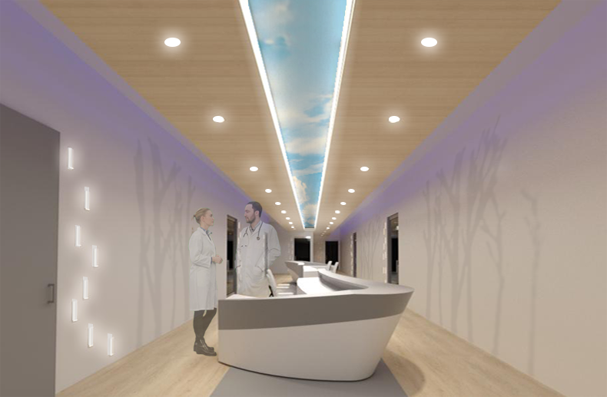
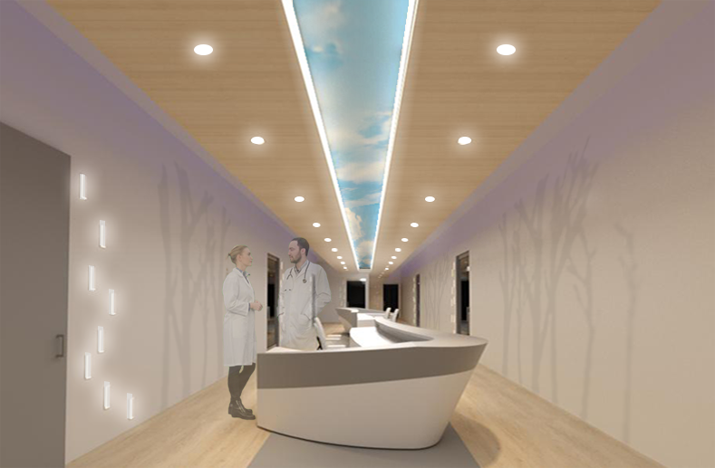
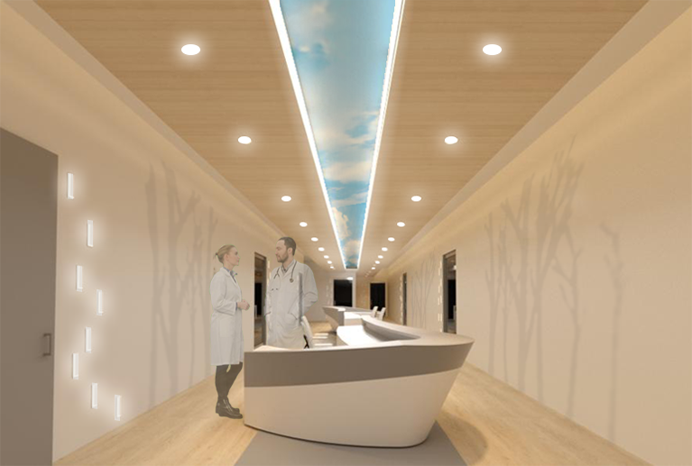
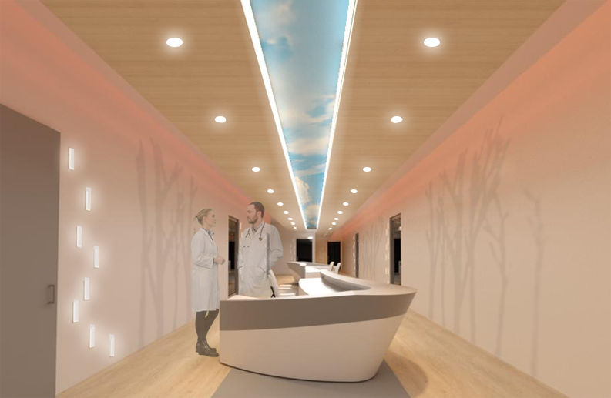
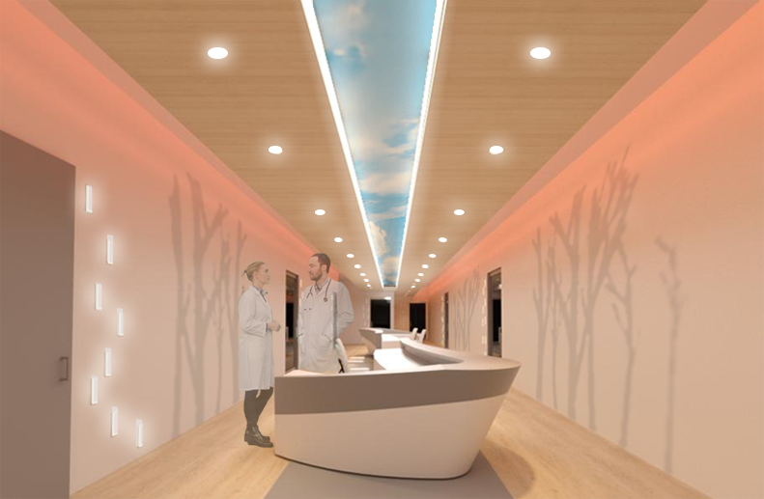
The Non-Profit Outpatient Medical Facility
Lighting Research Center Model Study On Circadian Rhythm Lighting
The Building
Overhead
Integrated + Sustainable Breadths
100% output
Lighting Design
Lobby Space
Daylighting Design
Lighting Design
Nurse Station
Lighting Design
Patient Room
Wall Washing Option 1
Electrical Depth
100% output
75% output
50% output
100% output
50% output
Concluding Thoughts
7:00 AM to 1:00 PM
1:00 PM to 4:00 PM
4:00 PM to 10:00 PM
10:00 PM to 1:00 AM
1:00 AM to 4:00 AM
4:00 AM to 7:00 AM

Slide 38
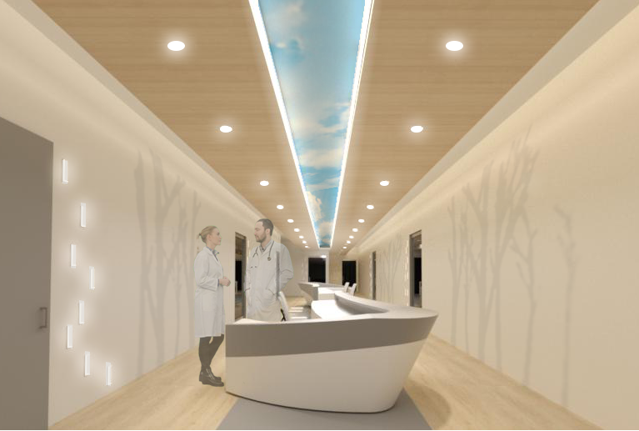
The Non-Profit Outpatient Medical Facility
The Building
Light
Integrated + Sustainable Breadths
Lighting Design
Biophilic Environment
Lobby Space
Daylighting Design
Lighting Design
Nurse Station
Mind
Lighting Design
Patient Room
Beauty + Spirit
Electrical Depth
Concluding Thoughts

Slide 39
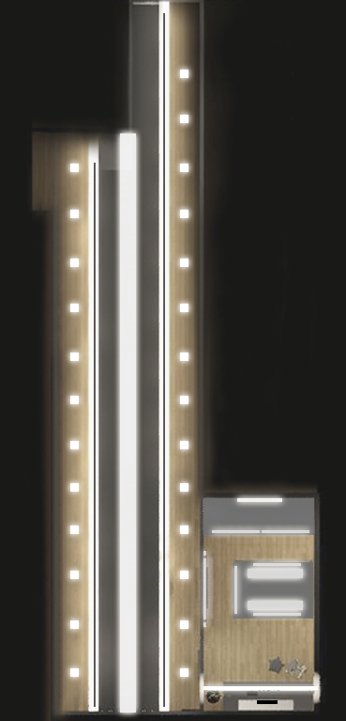
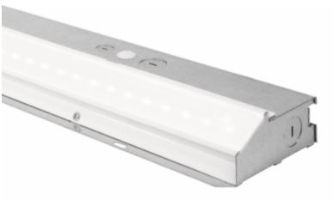
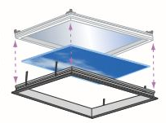
The Non-Profit Outpatient Medical Facility
The Building
Rotated Plan
Integrated + Sustainable Breadths
Lighting Design
Lobby Space
Daylighting Design
Nurse Station
Luminaire Selection
Lighting Design
Nurse Station
Lighting Design
Patient Room
Elevation
Electrical Depth
Concluding Thoughts

Slide 40
The Non-Profit Outpatient Medical Facility
IES + LRC Design Criteria
The Building
Space | Illuminance Level [hor] | Average Illuminance Level [hor] Calculated | Met Criteria? | Illuminance Level [vert] | Average Illuminance Level [vert] calculated | Met criteria?
Work Surface | 50 fc | 54 fc | Yes | 20 fc | 16 fc | no
General Circulation | 30 fc | 35 fc | Yes | 20 fc | 16 fc | no
Integrated + Sustainable Breadths
Lighting Design
Lobby Space
Daylighting Design
Design Solution
Lighting Design
Nurse Station
Lighting Design
Patient Room
Title 24 LPD Criteria
Electrical Depth
LPD Allowance: 1.2 W/SF
LPD Calculated: 1.2 W/SF
Met Criteria
Concluding Thoughts
LLF: 0.8

Slide 41
Patient Room
Lighting Design

Slide 42
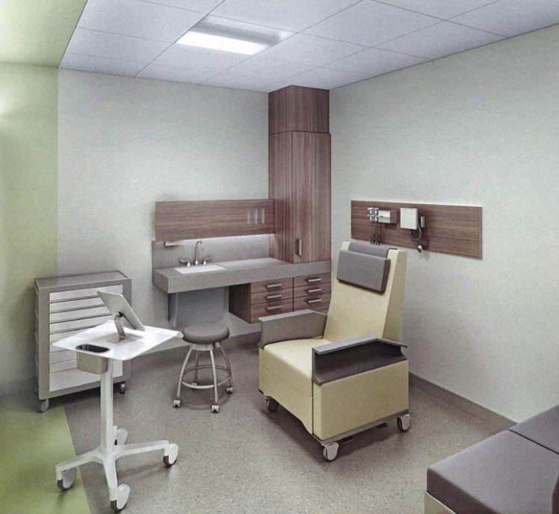
The Non-Profit Outpatient Medical Facility
The Building
Integrated + Sustainable Breadths
Modified Design
Fourth Level
Lighting Design
Lobby Space
Daylighting Design
Lighting Design
Nurse Station
Lighting Design
Patient Room
Electrical Depth
Concluding Thoughts

Slide 43
The Non-Profit Outpatient Medical Facility
The Building
Integrated + Sustainable Breadths
Family Visits + General Circulation
Patient Examination + Charting
Patient Reading
Lighting Design
Lobby Space
Daylighting Design
Lighting Design
Nurse Station
Lighting Design
Patient Room
Electrical Depth
Concluding Thoughts

Slide 44
The Non-Profit Outpatient Medical Facility
The Building
Control Zone 1
Control Zone 1I
Control Zone 1II
Integrated + Sustainable Breadths
Family Visits + General Circulation
Patient Examination + Charting
Patient Reading
Lighting Design
Lobby Space
Daylighting Design
Lighting Design
Nurse Station
Lighting Design
Patient Room
Electrical Depth
Concluding Thoughts

Slide 45
The Non-Profit Outpatient Medical Facility
The Building
Integrated + Sustainable Breadths
Lighting Design
Lobby Space
Daylighting Design
Control Zone 1
Lighting Design
Patient Examination + Charting
Nurse Station
Lighting Design
Patient Room
Electrical Depth
Concluding Thoughts

Slide 46
The Non-Profit Outpatient Medical Facility
The Building
Integrated + Sustainable Breadths
Lighting Design
Lobby Space
Daylighting Design
Control Zone 1I
Lighting Design
Patient Reading
Nurse Station
Lighting Design
Patient Room
Electrical Depth
Concluding Thoughts

Slide 47
The Non-Profit Outpatient Medical Facility
The Building
Integrated + Sustainable Breadths
Lighting Design
Lobby Space
Daylighting Design
Control Zone 1II
Lighting Design
Family Visits + General Circulation
Nurse Station
Lighting Design
Patient Room
Electrical Depth
Concluding Thoughts

Slide 48
The Non-Profit Outpatient Medical Facility
The Building
Light
Integrated + Sustainable Breadths
Lighting Design
Biophilic Environment
Lobby Space
Daylighting Design
Lighting Design
Nurse Station
Mind
Lighting Design
Patient Room
Electrical Depth
Beauty + Spirit
Concluding Thoughts

Slide 49
The Non-Profit Outpatient Medical Facility
Luminaire Selection
The Building
Integrated + Sustainable Breadths
Lighting Design
Elevation
Lobby Space
Daylighting Design
Lighting Design
Nurse Station
Lighting Design
Patient Room
Rotated Plan
Electrical Depth
Concluding Thoughts

Slide 50
The Non-Profit Outpatient Medical Facility
IES + LRC Design Criteria
Design Solution
The Building
Space | Illuminance Level [hor] | Average Illuminance Level [hor] Calculated | Met Criteria? | Illuminance Level [vert] | Average Illuminance Level [vert] calculated | Met criteria?
Patient Examination | 50 fc | 57 fc | Yes | 20 fc | 24 fc | Yes
Patient Reading | 40 fc | 57 fc | Yes | 20 fc | 24 fc | Yes
Charting | 30 fc | 34 fc | Yes | 15 fc | 24 fc | Yes
Family | 15 fc | 25 fc | Yes | 15 fc | 24 fc | Yes
General Circulation | 10 fc | 23 fc | Yes | 15 fc | 24 fc | Yes
Integrated + Sustainable Breadths
Lighting Design
Lobby Space
Control Zone 1
Daylighting Design
Patient Examination + Charting
Lighting Design
Nurse Station
Lighting Design
Patient Room
Title 24 LPD Criteria
Electrical Depth
LPD Allowance: 1.2 W/SF
LPD Calculated: 1.2 W/SF
Concluding Thoughts
Met Criteria
LLF: 0.8

Slide 51
The Non-Profit Outpatient Medical Facility
Design Solution
IES + LRC Design Criteria
The Building
Space | Illuminance Level [hor] | Average Illuminance Level [hor] Calculated | Met Criteria? | Illuminance Level [vert] | Average Illuminance Level [vert] calculated | Met criteria?
Patient Reading | 40 fc | 42 fc | Yes | 20 fc | 12 fc | no
Integrated + Sustainable Breadths
Lighting Design
Lobby Space
Control Zone 1I
Daylighting Design
Patient Reading
Lighting Design
Nurse Station
Lighting Design
Patient Room
Title 24 LPD Criteria
LPD Allowance: 1.2 W/SF
Electrical Depth
LPD Calculated: 1.2 W/SF
Met Criteria
Concluding Thoughts
Pink = 75% output
Blue = 60 % output
LLF: 0.8

Slide 52
The Non-Profit Outpatient Medical Facility
Design Solution
IES + LRC Design Criteria
The Building
Space | Illuminance Level [hor] | Average Illuminance Level [hor] Calculated | Met Criteria? | Illuminance Level [vert] | Average Illuminance Level [vert] calculated | Met criteria?
Family | 15 fc | 17 fc | Yes | 15 fc | 11 fc | no
General Circulation | 10 fc | 15 fc | Yes | 15 fc | 11 fc | no
Integrated + Sustainable Breadths
Lighting Design
Lobby Space
Control Zone 1II
Daylighting Design
Family Visits + General Circulation
Lighting Design
Nurse Station
Patient Room
Lighting Design
Patient Room
Title 24 LPD Criteria
LPD Allowance: 1.2 W/SF
Electrical Depth
LPD Calculated: 1.2 W/SF
Met Criteria
Concluding Thoughts
blue = 60% output
red = 40% output
LLF: 0.8

Slide 53
Electrical Depth
Back-Up Emergency Power

Slide 54
The Non-Profit Outpatient Medical Facility
The Building
1
2
3
4
HealthCare Back-Up Power Systems
Integrated + Sustainable Breadths
Normal Power
Life Safety Branch
Critical Branch
Equipment Branch
Lighting Design
Lobby Space
Emergency
Legally required standby
Optional standby
Daylighting Design
Lighting Design
Power for direct patient care
Medical gas equipment
Operating room HVAC systems
Heating for patient rooms
Cooling for data rooms
Other optional loads
Nurse Station
Egress lighting
Fire alarm + pump systems
Elevator car lighting + control systems
Emergency voice + alarm Comm Systems
Medical Gas Alarms
Medical Equipment Loads
Lighting Design
Patient Room
Electrical Depth
Concluding Thoughts

Slide 55
The Non-Profit Outpatient Medical Facility
The Building
480/277V, 3 phase, 4 wire
20,464 VA of Refrigeration back-up
Existing Back-up Power Conditions
Integrated + Sustainable Breadths
Lighting Design
Lobby Space
Daylighting Design
Lighting Design
Nurse Station
Portable
Generator
Lighting Design
Patient Room
50A transfer
switch
Electrical Depth
Concluding Thoughts

Slide 56
The Non-Profit Outpatient Medical Facility
The Building
2
3
4
1
Existing Back-up Power Conditions
Integrated + Sustainable Breadths
Critical Branch
Equipment Branch
Normal Power
Life Safety Branch
Lighting Design
Emergency
Legally required standby
Optional standby
Lobby Space
Daylighting Design
General Egress Lighting
General Circulation Lighting
Elevator lighting, Receptacles, + Motor
Motorized + Roll up Doors
Mechanical fire + Smoke Dampers
BIM System
Paging Systems
Sound Masking Systems
Security System
Medical Gas Alarms + manifold
3rd + 4th Floor Nurse Station Lighting
3rd + 4th Patient Lighting
Refrigeration
Server Racks
UPS System
Lighting Design
Nurse Station
Lighting Design
Patient Room
Electrical Depth
Concluding Thoughts

Slide 57
The Non-Profit Outpatient Medical Facility
First Floor
The Building
Second Floor
Third Floor
Redesigned Back-up Power Conditions
Integrated + Sustainable Breadths
Fourth Floor
Lighting Design
Lobby Space
Daylighting Design
Lighting Design
Nurse Station
Lighting Design
Patient Room
Electrical Depth
Concluding Thoughts

Slide 58
The Non-Profit Outpatient Medical Facility
The Building
Redesigned Back-up Power Conditions
Integrated + Sustainable Breadths
Lighting Design
Lobby Space
Daylighting Design
Lighting Design
Nurse Station
Lighting Design
Patient Room
Electrical Depth
Concluding Thoughts

Slide 59
The Non-Profit Outpatient Medical Facility
The Building
Redesigned Back-up Power Conditions
Integrated + Sustainable Breadths
Lighting Design
Lobby Space
Daylighting Design
Lighting Design
First Floor
Nurse Station
Lighting Design
Patient Room
Electrical Depth
Concluding Thoughts

Slide 60
The Non-Profit Outpatient Medical Facility
The Building
Redesigned Back-up Power Conditions
Integrated + Sustainable Breadths
Lighting Design
Lobby Space
Daylighting Design
Lighting Design
Nurse Station
Lighting Design
Patient Room
Electrical Depth
Concluding Thoughts

Slide 61
The Non-Profit Outpatient Medical Facility
The Building
Redesigned Back-up Power Conditions
100 kVA Generator
Integrated + Sustainable Breadths
Lighting Design
Lobby Space
Daylighting Design
Lighting Design
Nurse Station
Lighting Design
Patient Room
Electrical Depth
Concluding Thoughts

Slide 63
Acknowledgements
Dr. Houser, Dr. Mistrick, + Rich Koval
Mom + Dad
family + friends
L/E Class

Slide 64
Thank You!

